Slide 1
Videos Converts And
Converts really Mad!

Slide 2
increase your
website conversion

Slide 3
10x
your social media posts
An approach
best and most
effective way

Slide 4
videos are your
best shot

Slide 5
Secret

Slide 6
Video Marketing

Slide 7
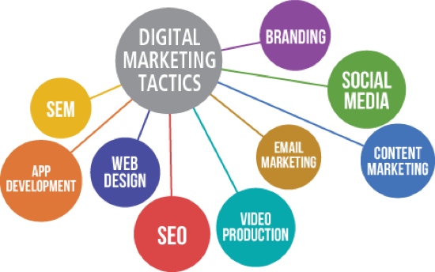
Other content
Videos convert
delivery medium
much more than

Slide 9
100% certainty
your answer
is VIDEO

Slide 10
The modern customer
service in action
wants to see your

Slide 11
laziest prospects can
Video marketing
consume your content
Captures Large Audience

Slide 12
70%
Marketers report
video converts

Slide 13
20%
or more conversion
Rate on website Videos

Slide 14
20%
or more conversion
Rate on Animated Videos

Slide 15
12.62%
Increased conversion
An Image to Videos

Slide 16
19%
Open Rate
Using the word Videos

Slide 17
80%
Users Recall
Videos watched last month

Slide 18
Almost 5 billion videos
Watched on YouTube

Slide 19
75 million people
Over 400 million people

Slide 20
100 hours of videos

Slide 21
Videos Converts And
Converts really Mad!

Slide 22
Making good and high
converting videos
ISN’T a NO-BRAINER

Slide 23
It actually requires a lot

Slide 24
✔ Premium tools to
create stunning Videos
✔ experts in video content delivery and marketing
✔ Expertise in video editing

Slide 25
It's more than just
putting a video out there

Slide 26
would it convert?

Slide 27
That’s where we come in

Slide 28
As an Agency
worked
many businesses

Slide 29
made countless videos
hundreds of video
many businesses

Slide 30
An arsenal of solid
perfect animated video
video creation software

Slide 31
Tested team
in
and video
content marketing
video editing

Slide 32
With our experience
we implement Video
marketing best practices

Slide 33
optimizing
our campaigns
Tracking
Maximum conversions

Slide 34
business with marketing
it could be challenging for you

Slide 35
sit & relax, while we
handle your video marketing

Slide 36
engage with your customers

Slide 37
Ready to take
advantage of this
game changer?

Slide 38
Contact Us
Today

