Slide 1
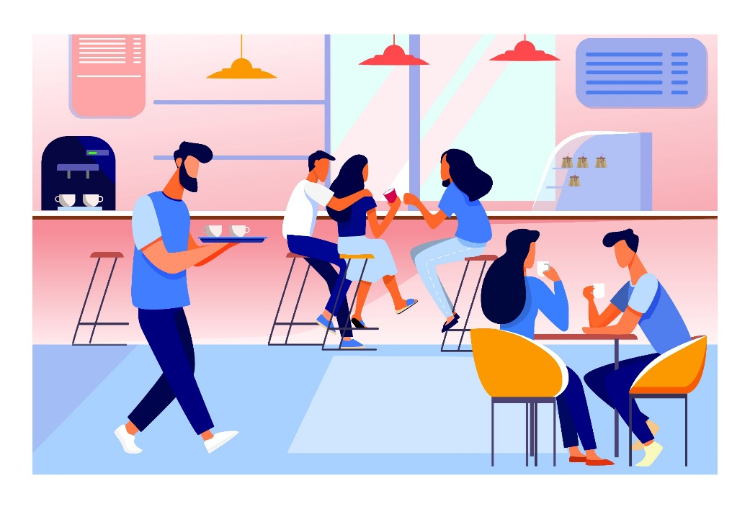
Attention
Cafe operators!

Slide 2
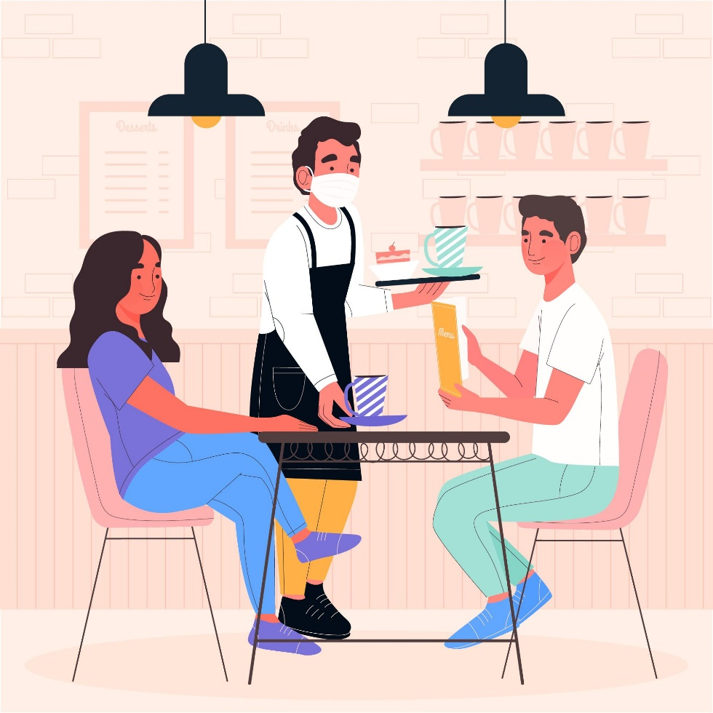
If you’re still 100% reliant
on only customers that come through your doors

Slide 3
you’re probably looking for a way to get
your business online so you can start getting
more orders coming in on a daily basis...

Slide 4
Then pay very close attention

Slide 5
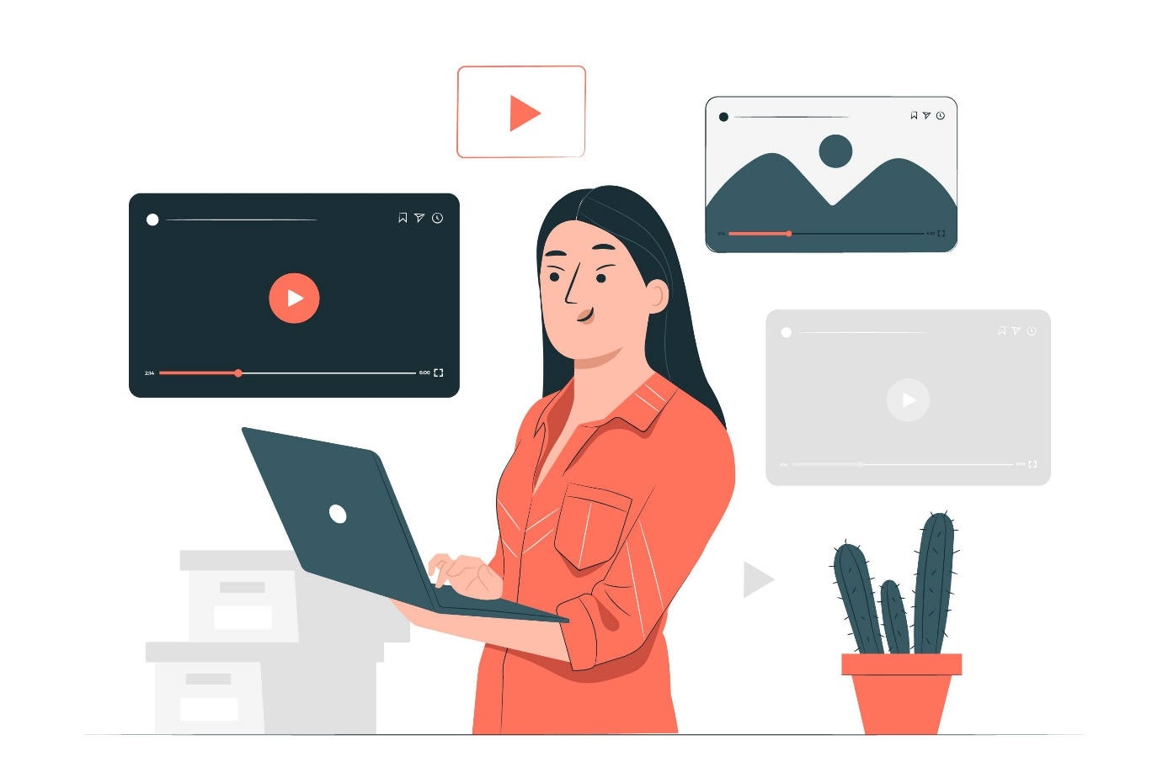
I’ll be revealing a simple strategy restaurants
operators are currently using to get tons of orders
daily from people they’ve never even met before

Slide 6
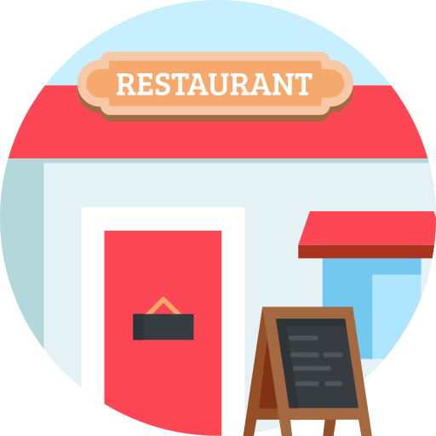
restaurant business has gone beyond brick and mortar
Digital

Slide 7
due to Covid,
to visit any public restaurant or eatery.
These days
too lazy
Probably too careful
are either too busy

Slide 8
They’ll rather place an order online as it’s far easy and much more convenient for them.

Slide 9
So that brings me to the gist of this video...

Slide 10
If your restaurant doesn’t have a web platform where you can conveniently receive and process orders,
then you stand the risk of the following;

Slide 11
You’re leaving tons of money on the table

Slide 12
you’re doing your customers a great disservice

Slide 13
your competitors are beating you to it and you’ll get out of business in no time, if you don’t go back to the drawing board.

Slide 14
And speaking of going back to the drawing board, check these out;

Slide 15
According to verified stats, digital ordering and delivery have grown 300% faster than dine-in traffic since 2014.

Slide 16
60% of US consumers order food delivery or takeout at least once a week.

Slide 17
34% of consumers in the US spend at least $50 per order when ordering food online.

Slide 18
There’s no doubt, online ordering is the future of this business, and the earlier you jump on the trend the better for you!

Slide 19
Just before you get excited

Slide 20
Setting up such a robust platform isn’t going to be any cheap or easy

Slide 21
you’ll need a proficient web developer

Slide 22
Digital marketing consultant

Slide 23
Digital marketing consultant

Slide 24
restaurant booking & menu software and a host of other resources.

Slide 25
Surely it’s going to cost you at
to set up fully, but trust me, it’ll be worth it at the end.
least $10, 000 - $15, 000

Slide 26
But wait a minute…

Slide 27
What If You Could Get A Professional And An Efficient Job Done At A Far Cheaper Price?

Slide 28
..And By A Team With An Outstanding Track Record That Understands Your Audience As Well As Your Business Needs!

Slide 29
I’m talking about a team that’ll help you;

Slide 30
Set up a dashing platform online that beautifully displays your available menu in realtime.

Slide 31
Deploy an interactive restaurant booking & menu option using a very effective in-house tool.

Slide 32
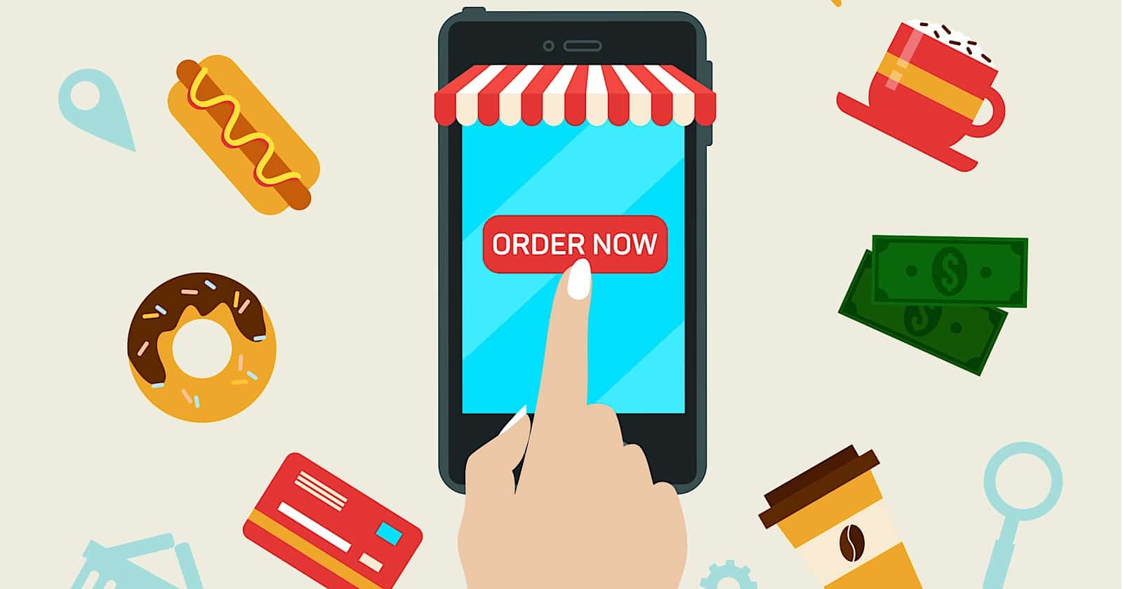
Make order placement and processing super simple and straightforward

Slide 33
Deploy our marketing expertise and experience to create buzz around your special offers.

Slide 34
And finally help you maintain and optimize the entire setup

Slide 35
Would you jump on it?

Slide 36
Of Course
you would!

Slide 37
So if you’re ready to take a leap in your business today, then click on the link below this video to contact us right now!

Slide 38
You need to act fast so you can secure a spot on our client list as we work only with a handful of businesses per time so as to deliver quality results

Slide 39
….Don’t miss out on this opportunity
Click the button below.

